Slide 1
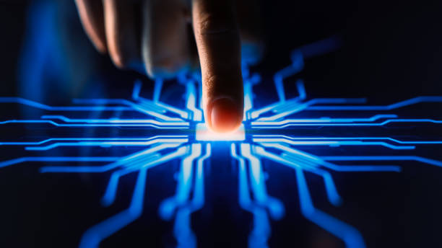
WELCOME TO THE WORLD OF JAVA
WHERE YOU WRITE ONCE & RUN IT EVERYWHERE
PREPARED BY
AMITA NARAYANAN KUTTY

Slide 2
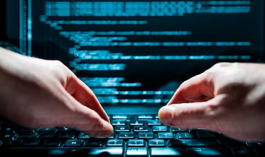
Heyyy it’s me Amita, an aspiring B tech student juggling every day with assignments but enjoying each and every bit of it…The idea of ppt and all these slides started when Ramaguru sir advised us to do research on a specific programming language…
From that day onwards a simple 4 letter word became my world…It caught my interest as this particular programming language was easy to write, compile, debug, and learn.
Then it was a long marathon from gathering data to setting it up on each slide.
The joy was in the running, the happiness was in the exploration and the smile was achieved when I opened the doors of a big wide world that the masses called JAVA !!

Slide 3
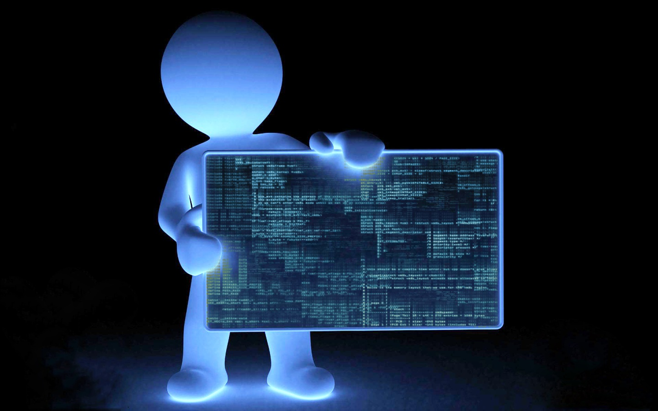
THE FIRST STEP LEADING TO JAVA
# LANGUAGE HISTORY

Slide 4
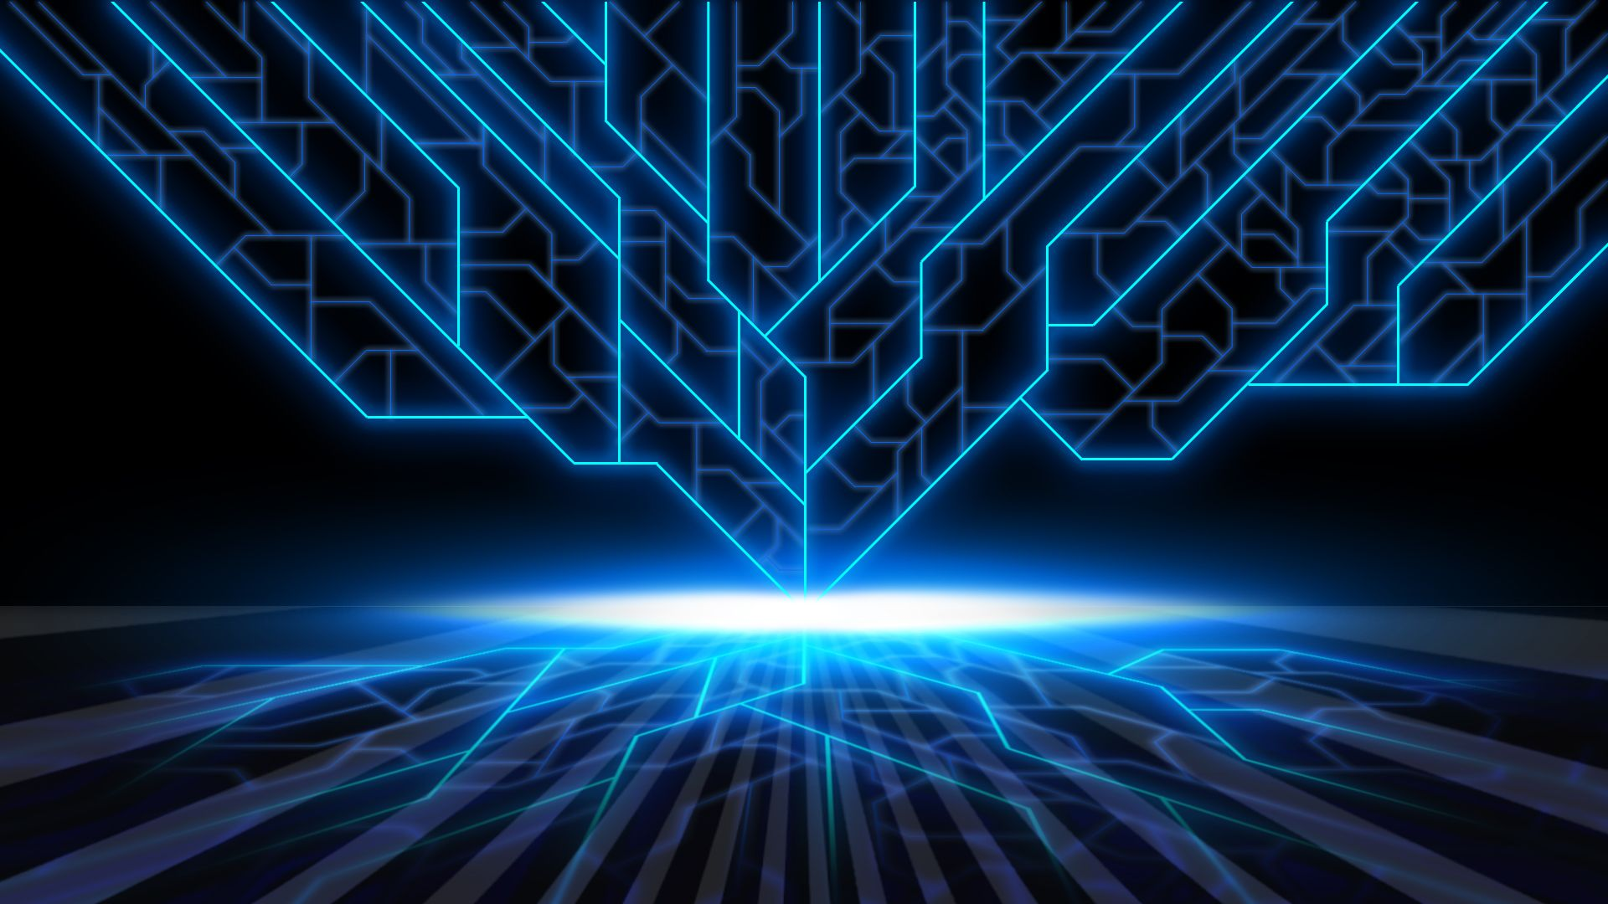
HISTORY
When we dive deeper into the history of java, we find that it is way more interesting than we thought.
Java was originally designed for interactive television, but it was too advanced technology for the digital cable television industry at that time. The history of Java starts with the Green Team.
Java was developed by James Gosling, who is known as the father of Java, in 1995. James Gosling and his team members started the project in the early '90s. James Gosling, Mike Sheridan, and Patrick Naughton initiated the Java language project in June 1991.
The small team of sun engineers was called Green Team. Initially, Java was designed for small systems in electronic appliances like set-top boxes. Firstly, it was called "Green talk" by James Gosling. After that, it was called Oak and was developed as a part of the Green project.

Slide 5

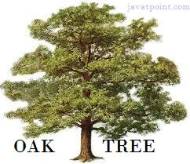
HISTORY
Why was Java named "Oak"?
Oak is considered as a symbol of strength and chosen as a national tree of many countries like the U.S.A., France, Germany, Romania, etc. In 1995, Oak was renamed "Java" because it was already a trademark by Oak Technologies.
How did java language get the name java?
The team gathered to choose a new name. The suggested words were "dynamic", "revolutionary", "Silk", "jolt", "DNA", etc. They wanted something that reflected the essence of the technology: revolutionary, dynamic, lively, cool, unique, easy to spell, and fun to say. According to James Gosling, "Java was one of the top choices along with Silk". Since Java was so unique, most of the team members preferred Java to other names.
Java is an island in Indonesia where the first coffee was produced (called Java coffee). It is a kind of espresso bean. The name JAVA was chosen by James Gosling while having a cup of coffee nearby his office.
Java was initially developed by James Gosling at Sun Microsystems (which is now a subsidiary of Oracle Corporation) and released in 1995. In 1995, Time magazine called Java one of the Ten Best Products of 1995.

Slide 6
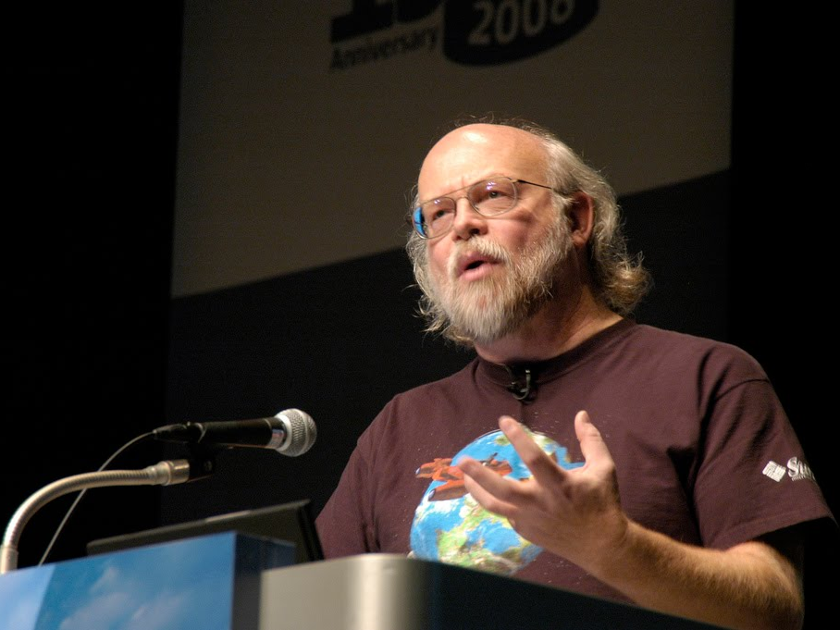
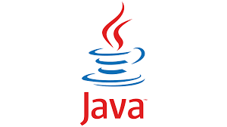
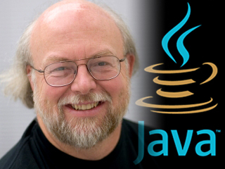

Slide 7
THE SECOND STEP LEADING TO JAVA
# GLOSSARY

Slide 8

List of few Java Terms: Things Every Java Developer Should Know
Abstract Class
An abstract class is a class that is declared as abstract by a keyword in Java. This means that the class cannot be instantiated and it is impossible to create an object. Instead, it is inherited by other classes.
Data Type
A data type is a specifier that determines the value size and type that can be contained in a variable.
Java Operators
Java operators are special symbols used to perform specific functions on variables and values.
Java Platform Editions
Java platform editions are the programming environments where Java applications run. They contain a Java virtual machine and an application programming interface that allows applications and programs to run.
Java Exceptions
A Java exception is any issue that arises during program execution that may disrupt the flow of the program’s instructions.

Slide 9
THE THIRD STEP LEADING TO JAVA
# TYPES OF PROGRAMMING LANGUAGES

Slide 10
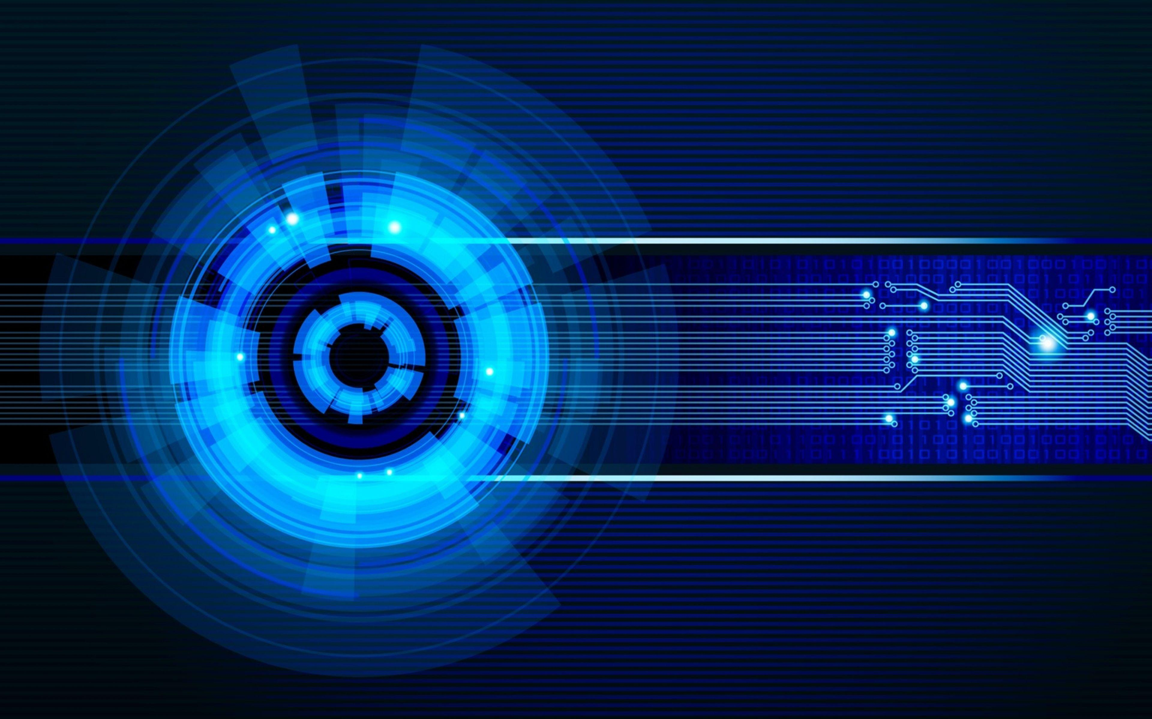
TYPES OF PROGRAMMING LANGUAGES
There are basically two types of computer programming languages, as given below:
1.Low-level languages
2.High-level languages
Low-Level Languages
The programming languages that are very close to machine code (0s and 1s) are called low-level programming languages. The program instructions written in these languages are in binary form.
These are the two types of low-level computer languages.
1.Machine language
2.Assembly language
High-Level Languages
Programming languages that are the most like the language (English) spoken by humans are known as "high-level languages."
Types of High-level Languages
The high-level programming languages can be further broken down into the following categories:
1.Procedural languages
2.Non-procedural languages
3.Object-oriented programming languages

Slide 11
DIFFERENCE BETWEEN HIGH-LEVEL AND LOW-LEVEL PROGRAMMING LANGUAGE
HIGH-LEVEL LANGUAGES
LOW-LEVEL LANGUAGES
Very easy to understand.
Debugging is not very difficult.
A user can port them from one location to another.
They are very widely used and popular in today’s times.
Java, C, C++, Python, etc., are a few examples of high-level languages.
Difficult to understand.
Debugging them is very difficult.
They are not portable.
Low-level languages do not have a very wide application in today’s times.
Binary code, and machine language are a few examples of high-level languages.

Slide 12
THE FOURTH STEP LEADING TO JAVA
# PROGRAMMING PARADIGMS

Slide 13

PROGRAMMING PARADIGMS
From a layman’s point of conviction, programming paradigms are a fundamental style of computer programming.
Technically, a programming paradigm is a way to deal with and tackle issues utilizing some programming language. Additionally, we can say that it is a strategy to take care of an issue using tools and techniques that are accessible to us following some methodology.
There are two programming paradigms. They are:
Imperative Programming Paradigm - Imperative programming is a programming paradigm that uses statements that change a program's state. Eg: - C, Fortran, Basic, Java, C++
Declarative Programming Paradigm - Declarative programming is a style of building the structure and elements of computer programs. It expresses the logic of a computation without describing its control flow. Eg: -Scala, Haskell, Erlang
Java is multi-paradigm. That is, it is generic, object-oriented (class-based), functional, imperative, reflective, and concurrent.

Slide 14
THE FIFTH STEP LEADING TO JAVA
# INFLUENCED AND INFLUENCER

Slide 15
INFLUENCED AND INFLUENCER
INFLUENCED
The syntax of Java is largely influenced by C++ and C. Unlike C++, which combines the syntax for structured, generic, and object-oriented programming, Java was built almost exclusively as an object-oriented language.
INFLUENCER
Scala is a statically typed language that is based on Java. Thus, anyone who's well-versed in Java's syntax will find it pretty easy to learn Scala.
We must explicitly implement a Java interface within our Jython class. This will allow the Python interpreter to coerce our object later.
Apache Groovy is a Java-syntax-compatible object-oriented programming language for the Java platform.

Slide 16
THE SIXTH STEP LEADING TO JAVA
# IMPLEMENTATION

Slide 17
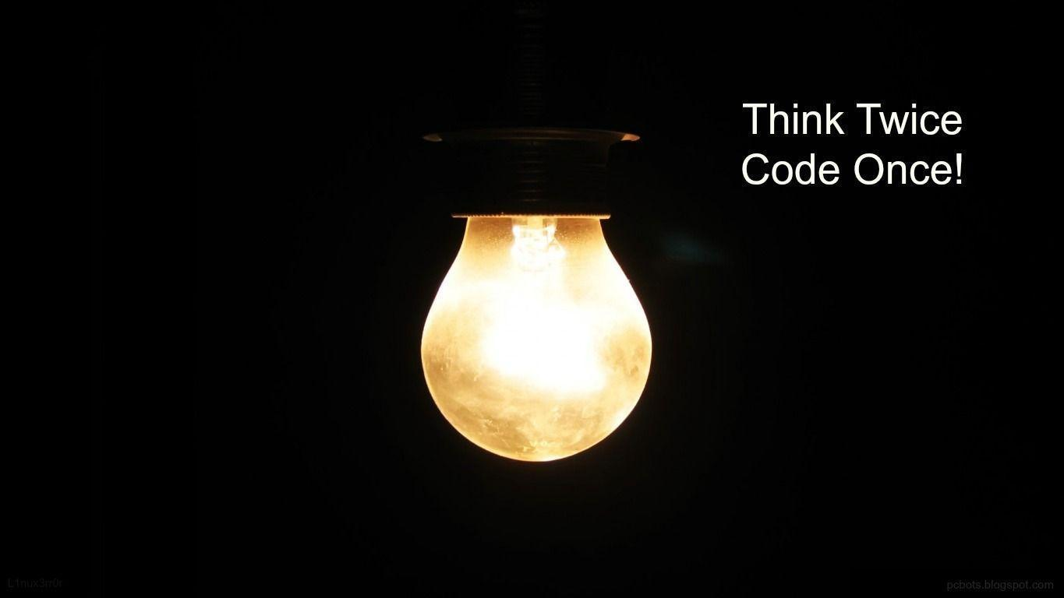

Slide 18
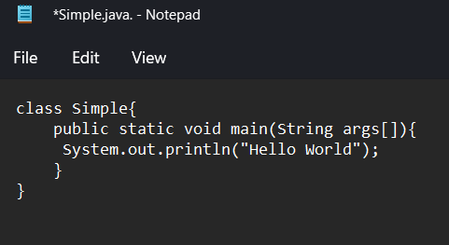
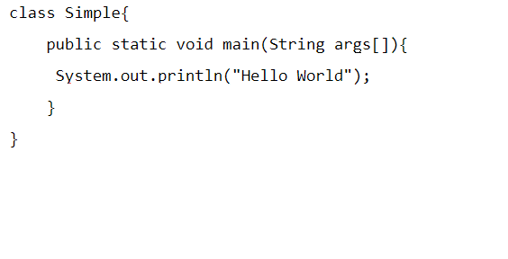
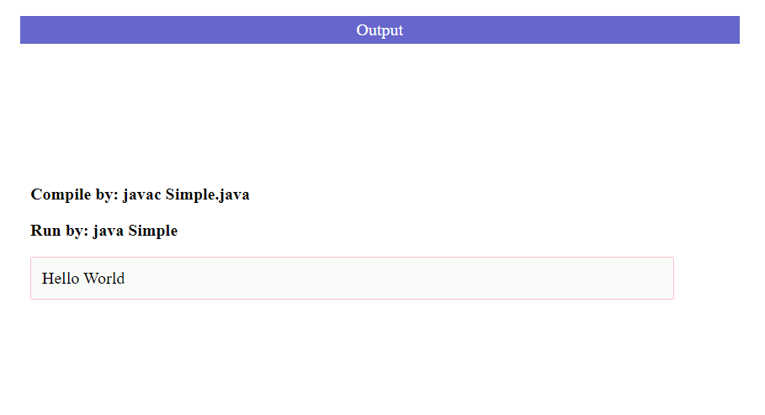
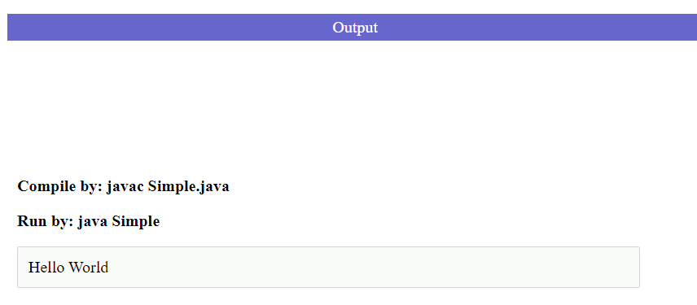
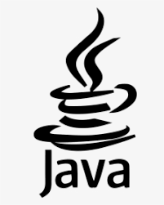
Classes act as the building blocks for the overall application in Java. You can have separate classes for different functionalities.
Every Java program must have a main method. When the Java compiler starts executing our code, it starts from the main method.
We use the System.out.println() statement to print information to the console. The statement takes an argument. Arguments are written between parentheses.
In the "Hello World!" program HELLO WORLD is an argument and is surrounded by quotation marks. This tells the compiler that the argument is a string. Strings in programming are just a collection of characters.

Slide 19
THE SEVENTH STEP LEADING TO JAVA
# APPLICATIONS

Slide 20

APPLICATIONS OF JAVA
Java has become the most robust programming language because of its amazing features. Some of its features are
Platform independence
High performance
Object orientation
Support for automatic garbage management and many more.
The top ten most useful applications of java are: -
1. Desktop GUI Applications
2. Mobile Applications
3. Artificial intelligence
4. Web applications
5. Big Data technology
6. Gaming applications
7. Business applications
8. Embedded systems
9. Cloud applications
10. Scientific applications

Slide 21
THE EIGHTH STEP LEADING TO JAVA
# STAY MOTIVATED

Slide 22
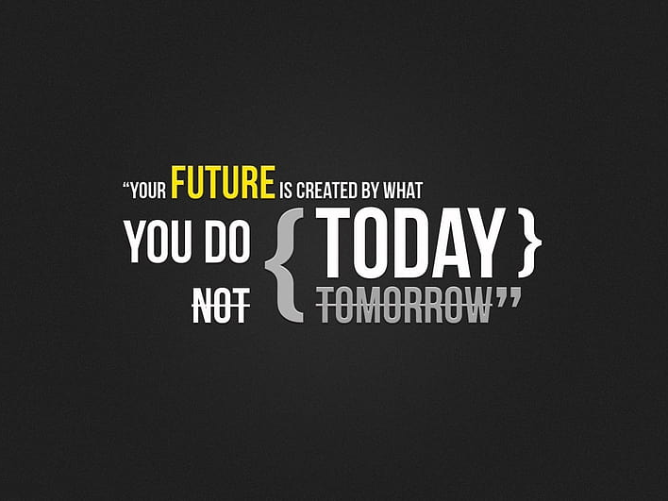


Slide 23
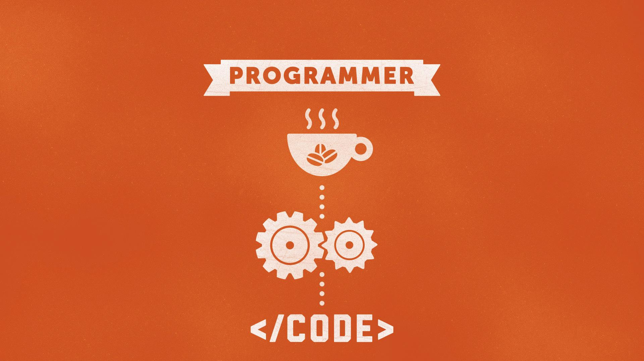
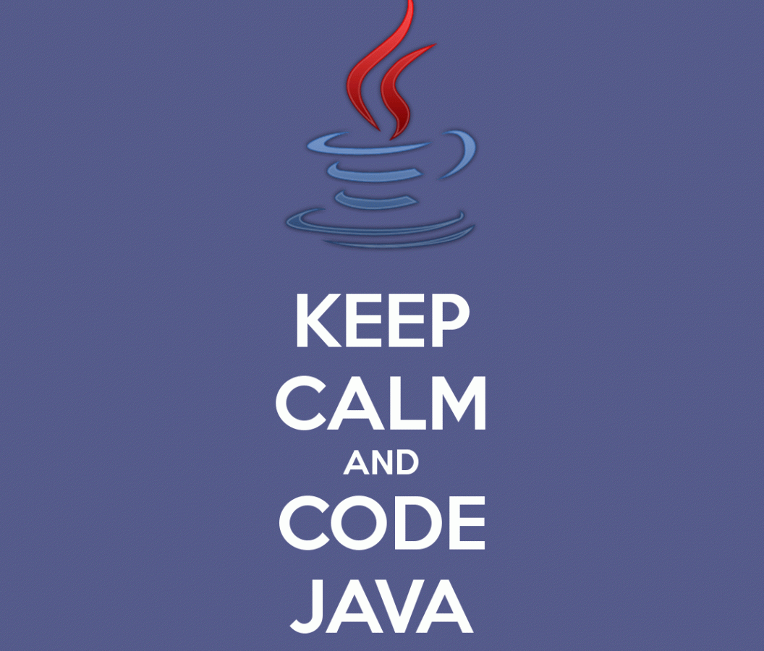
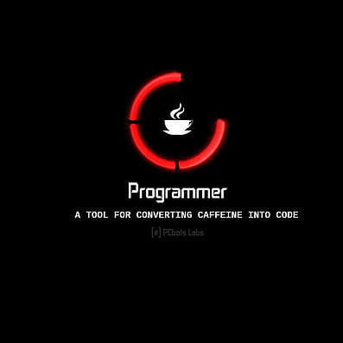
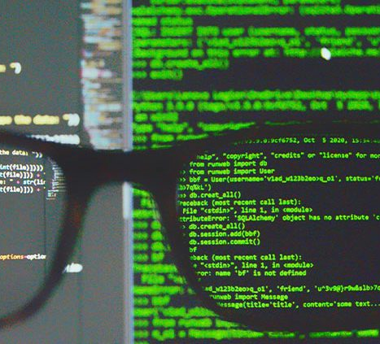
END OF PPT BUT NOT THE END OF OUR IMAGINATION !!
EXPLORE JAVA BECAUSE AT THE END OF THE DAY A COMPUTER, A PROGRAMMING LANGUAGE, AND AN ENTHUSIASTIC PROGRAMMER NOT WITH AN INSTANT CUP OF COFFEE BUT WITH AN INSTANT CUP OF JAVA CAN CHANGE THE WORLD …
SIGNING OFF
AMITA NARAYANAN KUTTY
ROLL NO - 67
CYS(2022-26)

